Slide 1
2024 美時集團供應商會議 Lotus Group Supplier Conference
Oct 16th 2024

Slide 2
Meeting Rules
會議時間：15:00 ~17:00
請將問題留到最後
手機全程靜音

Slide 3
Meeting Agenda
會議開幕 Opening of Conference by Ella Tsai
法規要求 Regulatory Expectations by Winnie Chen
資訊安全 Cyber Security by Gwen Hsieh
美時集團 ESG 期望 Lotus Group ESG Expectations
供應商行為準則 Supplier Code of Conduct
供應商入口網站 Introduce Supplier Portal
閉幕 Closing

Slide 4
美時與供應商合作共創美好世界 Lotus Collaboration with Suppliers for a Better World
了解ESG Acknowledging ESG
了解供應商行為準則 Acknowledging Supplier Code of conduct
啟動溫室氣體 (GHG)盤點 Initiating Greenhouse Gas (GHG) Inventory
2027 年前披露並提供其範疇 1、範疇 2 和範疇 3 的溫室氣體排放數據 Disclose and provide your company‘s GHG Scope 1, 2, and 3 emissions by 2027.
設定 2030 年溫室氣體減排目標 Setting 2030 GHG Emission Reduction Goal
2027 年前建立溫室氣體 (GHG) 排放基線並設定減排目標 Establishing a greenhouse gas (GHG) baseline and reduction targets by 2027.

Slide 5
Regulatory Affairs by Winnie Chen

Slide 6
Agenda
1
RA participation
2
Requirement for submission
3
Variation approval timeline/Current challenges

Slide 7
RA Participation!!
Product development
Regulatory feasibility for different markets
Regulatory opinions and advise
Consultation to the regulatory agency
Provide regulatory strategy for each region/market based on the IP/exclusivity status and dossier availability
Submission
CTD writeup
Dossier preparation and submission
Deficiency letter management
B2B customer submission communication
Label preparation for timely product launch
Post approval
Product lifecycle management
License renewal
Labelling renewal
Pharmacovigilance

Slide 8
Requirement for submission
Drug Substance | Excipients | Package materials
DMF/ASMF in ICH eCTD structure | Vendor COA | Vendor COA
Elemental Impurity Assessmentwith analysis result | Elemental Impurity Assessment And Statement | Suitable For Food And Drug Use Statement (Compliance Of Certificate For Bottle/Cap/Liner/Desiccant/Bulk LDPE Bags) Should Complied With Following Regulatory:-10/2011 -Ph.Eur. 3.1.3 -Ph.Eur.3.2.2.
Nitrosamine Impurity Assessment with analysis result | Nitrosamine Impurity Assessment And Statement and IPEC form | Technical Data Sheet
Residual Solvent Statement | Residual Solvent Statement | Cap/Bottle Drawing (If Available)
GMP from EU, US or other authoritative country | Pork Free Statement, if applicable | ISO- 8317 Certificate (Child Resistance)- EU
Manufacturing license | Alcohol Free Statement, if applicable | USP 661/671- Performance Study (US)
Outsourcing Lab information, for relevant drug substance | Melamine Statement, if applicable | LOA For DMF(US)
GMP statement for intermediate and starting materials | Non-gmo Statement, if applicable | -
Structural elucidation report for primary standards and COA | Compositions, Premix Excipient Such As Opadry, Hard Capsule, SMCC Etc.. | -
- | Allergen Statement | -
- | Confirmation of USPNF&EP compliance | -
- | Confiramtion of JP/JFE compliance | -

Slide 9
Drug substance
Expectation from supplier
DMF is important for us to evaluate when it is new alternative source or there is any changes. (完整DMF文件對評估一個新來源原料或原料變更非常重要)
For DMF RP, we understand RP is confidential, but we need to understand the changes in RP when there is any changes, this help to evaluate the variation level. (DMF 變更層級需依據AP及RP的變更内容來評估，因此，RP中變更資訊非常重要)
Don’t change the DMF/CEP so frequently, this help to reduce the variations. (請盡可能減少DMF及CEP變更的頻率)
Excipient & package material
If there is any plan to stop the supply, please inform us in advance. It will take time to introduce a new source although the specification remain same. (如果有已知任何停產計劃，請儘早通知，對於有些市場來説，新增來源仍需等待官方核准，即使規格沒有改變)
If there is any change proposed by supplier, please inform us immediately. (如果有任何變更，請立即通知)

Slide 10
Variation: Approval timeline differ territories wise for same variation.
Drug substance batch size scale up (within 10-fold)
Variation plan | Critical market | Variation level | Approval timeline
Drug substance batch size scale up (Within 10-fold) | EU | Type IA | Annual report
 | VN | Minor change | 18-24M
Alternative excipient supplier (same specification)
Variation plan | Critical market | Variation level | Approval timeline
Alternative excipient supplier (same specification) | EU | No variation is required | No variation is required
 | CO | Notification | 6M

Slide 11
Lotus Vendor Conference
Gwen Hsieh

Slide 12
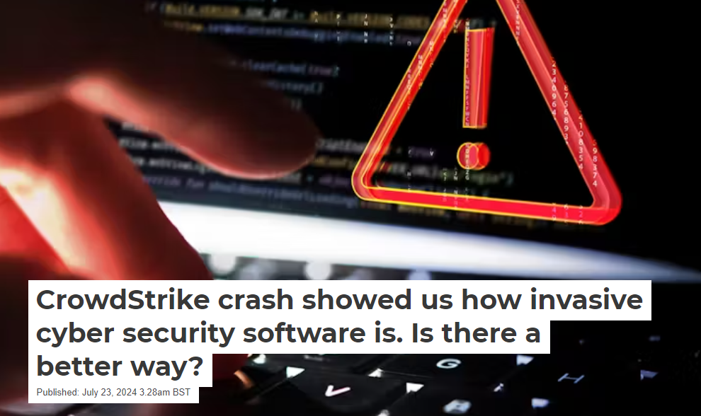
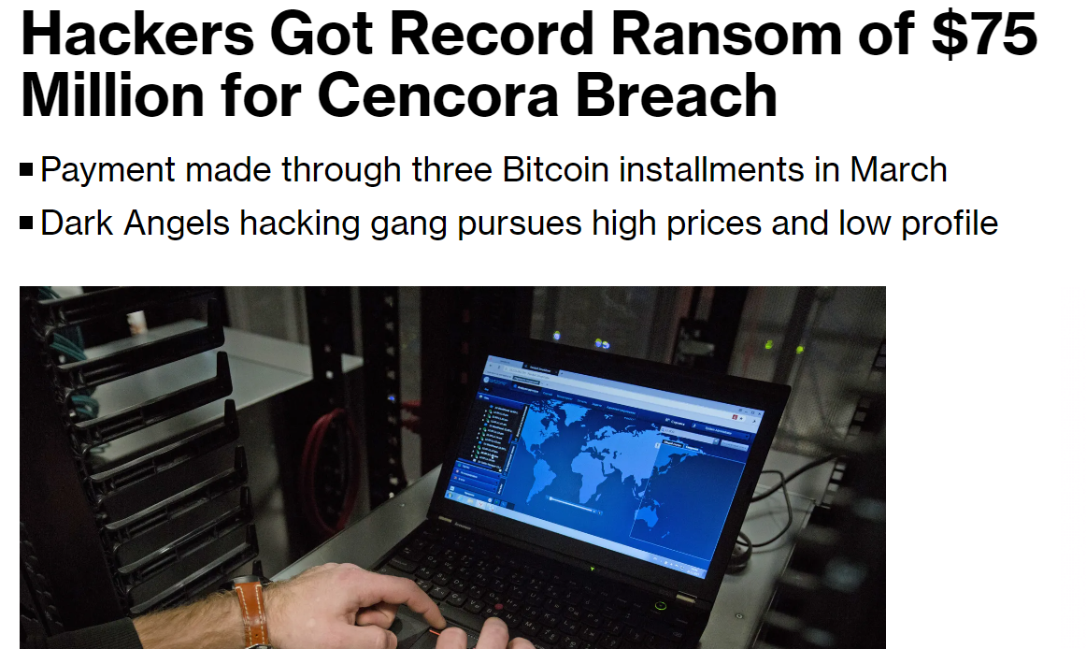
It did happen!
CrowdStrike outage
Cencora data breach
11 drug companies that partner with Cencora have disclosed data breaches of their own. These include:
Bayer Corporation – major pharmaceutical firm known for the origin and first marketing of aspirin.
Novartis Pharmaceuticals – one of the largest pharmaceutical companies in the world.
Regeneron Pharmaceuticals Inc – known for ophthalmology, oncology and immunology treatments.
AbbVie Inc – the creator of Humira, used to treat rheumatoid arthritis, among other things.
Incyte Corporation – developer of drugs like Jakafi which is used to treat a type of bone marrow cancer called myelofibrosis.
Genentech Inc – a leader in biotechnology which has made strides in the treatment of cancer.
Sumitomo Pharma America Inc – specialises in neurology, oncology, and psychiatry.
GlaxoSmithKline Group – a global organisation catering to a wide range of medical treatments such as vaccines, pharmaceuticals and consumer healthcare.
Acadia Pharmaceuticals Inc – creates treatments for central nervous system disorders.
Endo Pharmaceuticals Inc – develops medication for areas such as urology, endocrinology and pain management.
Dendreon Pharmaceuticals LLC – specialises in oncology and developing immunotherapy treatments for prostate cancer.
CrowdStrike (NASDAQ: CRWD) is facing lawsuits from investors and customers following the incident that caused massive global outages, but some believe the company is likely shielded from legal action. On July 29, Delta informed CrowdStrike and Microsoft of its intent to sue over the $500 million it claims to have lost as a result of the outage

Slide 13
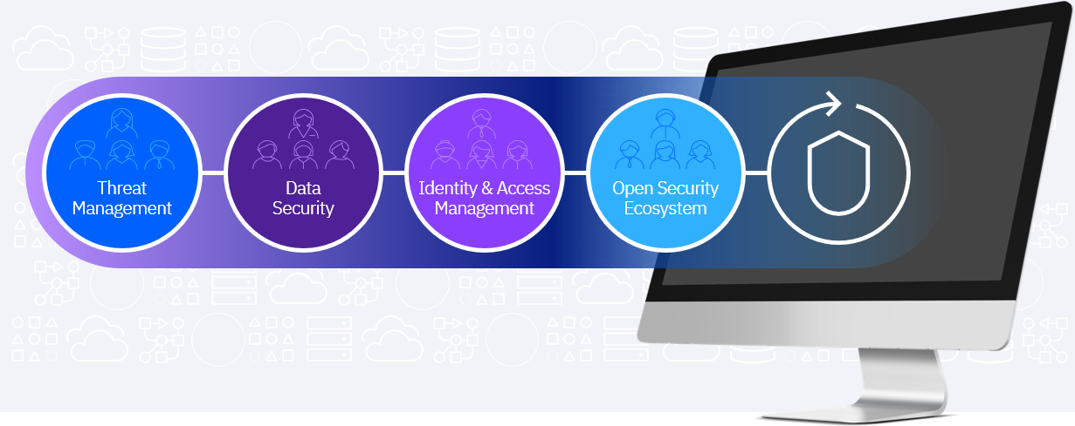
Cybersecurity Strategy & Practice
A. Cybersecurity Standards and Policies
Establish Supplier Cybersecurity Standards
Enforce Compliance
B. Incident Response Collaboration
Joint Incident Response Planning
Breach Notification Obligations
Incident Drills
C. Data Access Control and Encryption
Limit Data Access
Data Encryption
D. Supplier Offboarding
Data Return and Disposal
Access Removal
E. Regulatory Compliance and Industry Standards
Compliance with Laws and Regulations
Industry Certifications
F. Supplier Security Training and Awareness
Cybersecurity Awareness
Training on Supply Chain Risks
G. Supply Chain Cybersecurity Regulations
Supply Chain Security Regulations
Global Supply Chain Risk Management

Slide 14
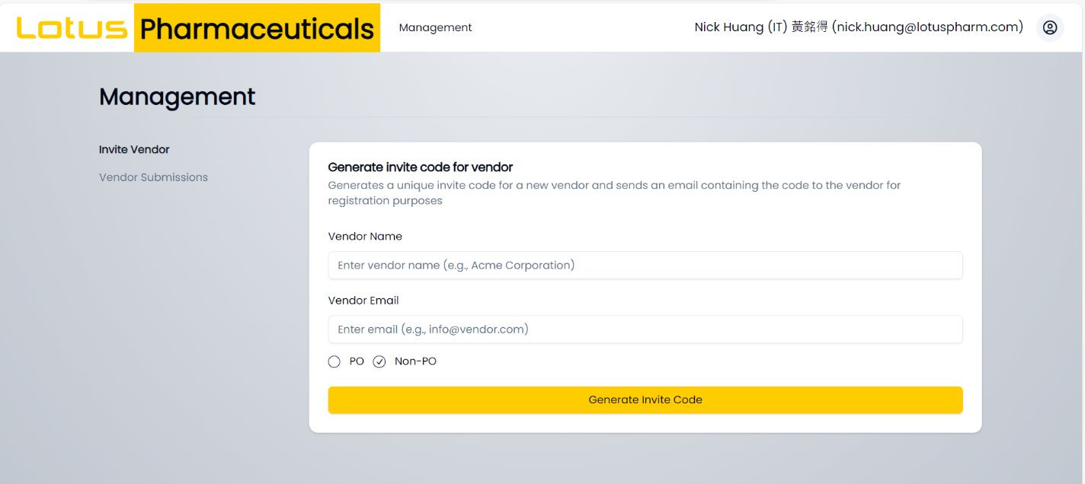
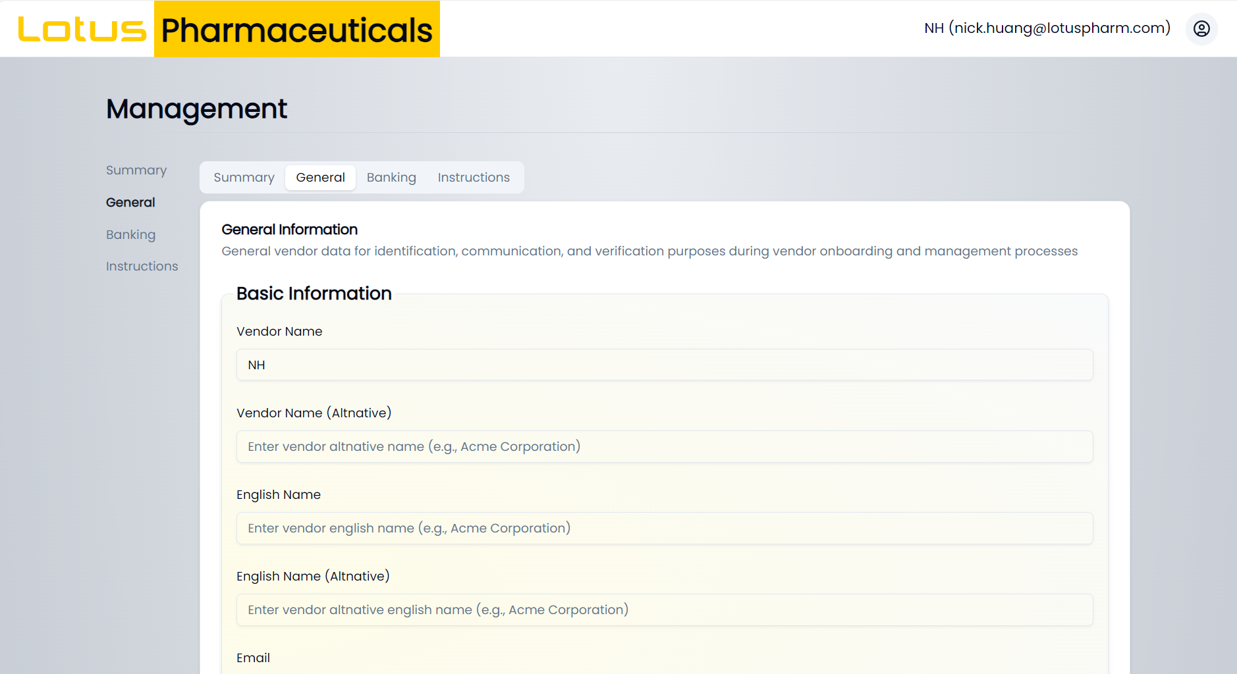
Lotus vendor portal coming soon

Slide 15
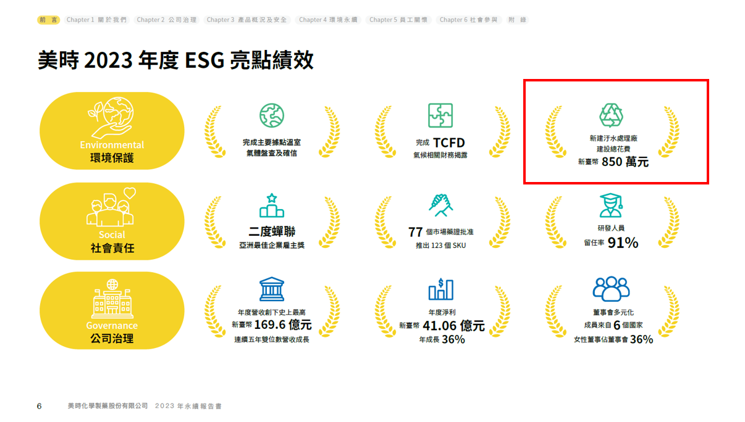

Slide 16
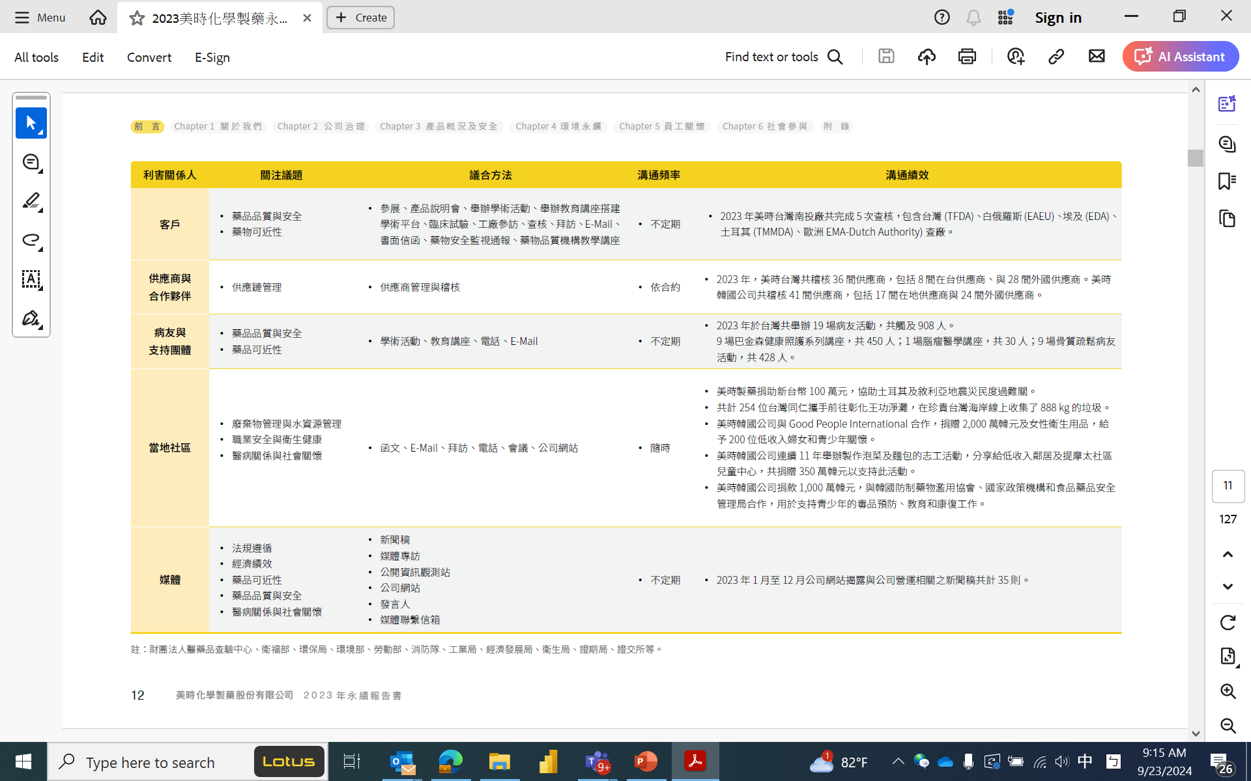

Slide 17
美時價值鏈
上游 :
供應商審查
定期稽核評估
建立穩定合作
保持順暢溝通
下游 :
多元銷售通路
自行銷售
策略合作夥伴
向外授權

Slide 18
透過供應商參與連結上下游
Supplier Qualification
供應商審查
QTA / Service agreement
品質/服務協議
Auditing / Visiting
稽核/拜訪
ESG Engagement
ESG參與
Two ways feedback
雙向溝通
KSM / Raw materials
4 PL/ Transportation/ Distributor
We will reach out to you for supply chain E2E ESG engagement
邀請您參與供應鏈端對端ESG

Slide 19
供應商管理計畫
供應商管理Supplier Management Program
供應商鑑別
管理流程及方法
供應商評鑑
新供應商篩選
供應商風險評估

Slide 20
供應商管理計畫
供應商管理Supplier Management Program
供應商鑑別
管理流程及方法
供應商評鑑
新供應商篩選
供應商風險評估

Slide 21
供應商管理計畫
供應商管理Supplier Management Program
供應商鑑別
管理流程及方法
供應商評鑑
新供應商篩選
供應商風險評估

Slide 22
供應商管理計畫
供應商管理
Supplier Management Program
供應商鑑別
管理流程及方法
供應商評鑑
新供應商篩選
供應商風險評估

Slide 24
ESG & Supplier Code of conduct​ 供應商行為準則​

Slide 25
Commitment Sought 我們承諾
企業社會責任
公司致力於維護人權，確保公平的工資，尊重結社自由和集體談判。這一承諾反映了對道德商業行為和資訊披露透明度的專注。
公司的承諾延伸到在懷孕和分娩期間保護女性員工，展示了確保員工福祉的綜合方法。
永續環境發展
公司承諾減少對環境的影響，節約資源，並跟蹤能源和資源消耗，這與商業世界對實踐永續的日益重視一致。
勞工與人權
自願就業
禁止童工
尊重結社自由
健康與安全
職業安全
健康與安全資訊
應急應變措施

Slide 26
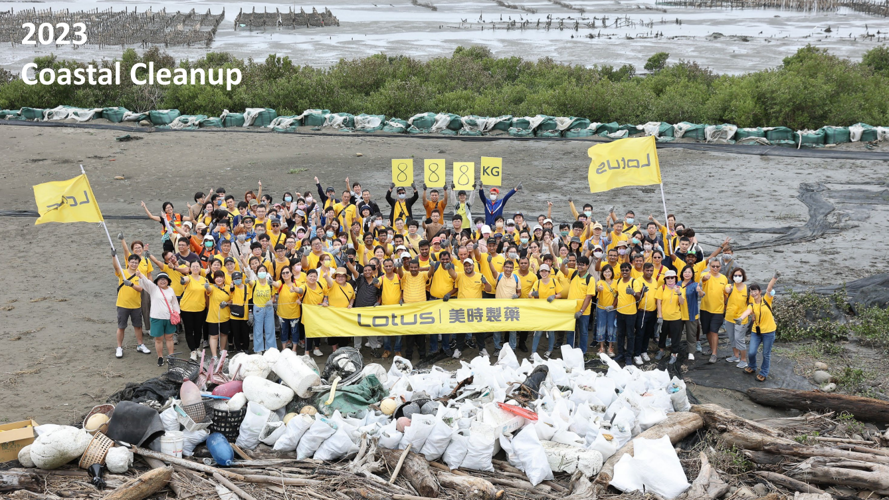

Slide 27
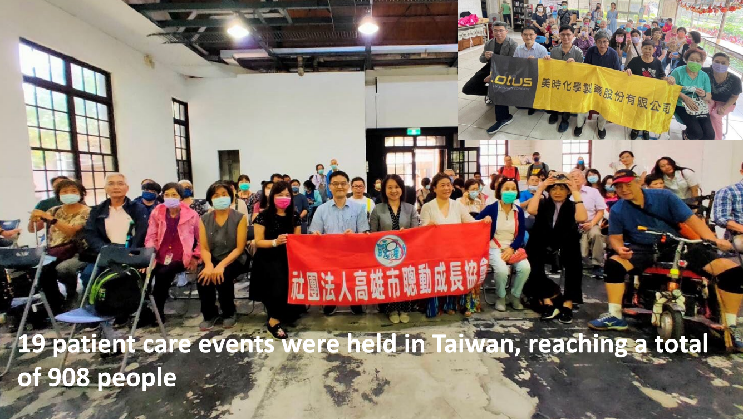

Slide 28
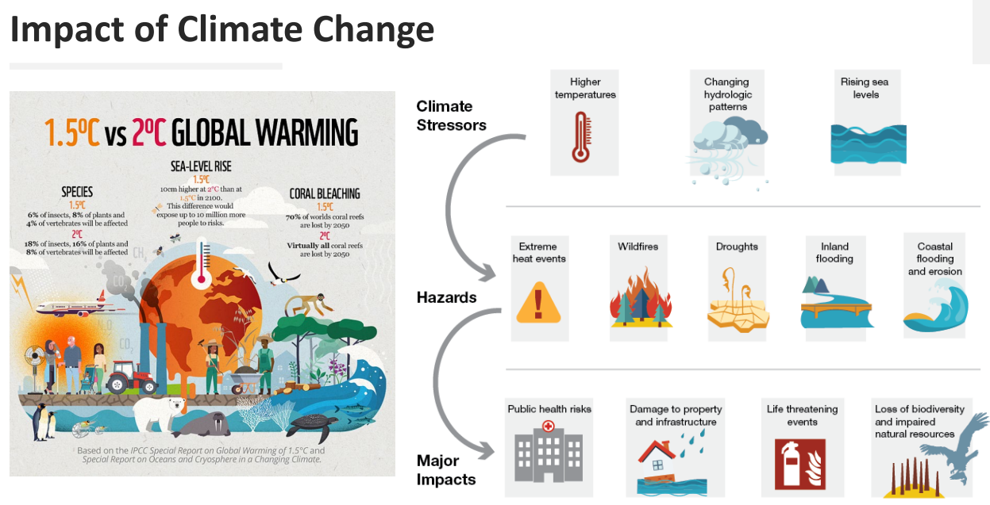
Environmental sustainability & Impact 永續環境發展
Minimising Environmental Impact
對環境的影響最小化
公司致力於將環境影響降至最低並獲得環境許可，這反映了公司對永續環境的積極態度。
Resource conservation
節約資源
通過節約資源和跟蹤能源和資源消耗，公司與對永續資源管理的日益重視保持一致。
Pollution Prevention
污染防治
公司專注於污染防治和控制廢水和空氣排放，這表明對環境管理的承諾。

Slide 29
Ethical standards and Transparency 道德標準和透明度
資訊披露的透明度
公司致力於資訊披露的透明度以及與審計機構的合作，這反映了對道德商業行為和問責制的專注。
知識產權保護
尊重智慧財產權和資訊保密性表明公司對維護道德標準和保護專有信息的承諾。
避免利益衝突
公司致力於避免利益衝突，體現了對道德商業實踐和誠信的專注。
所有商業交易皆以道德誠信為宗旨

Slide 33
供應商入口網站 Supplier Portal by Rebecca Liu

Slide 34
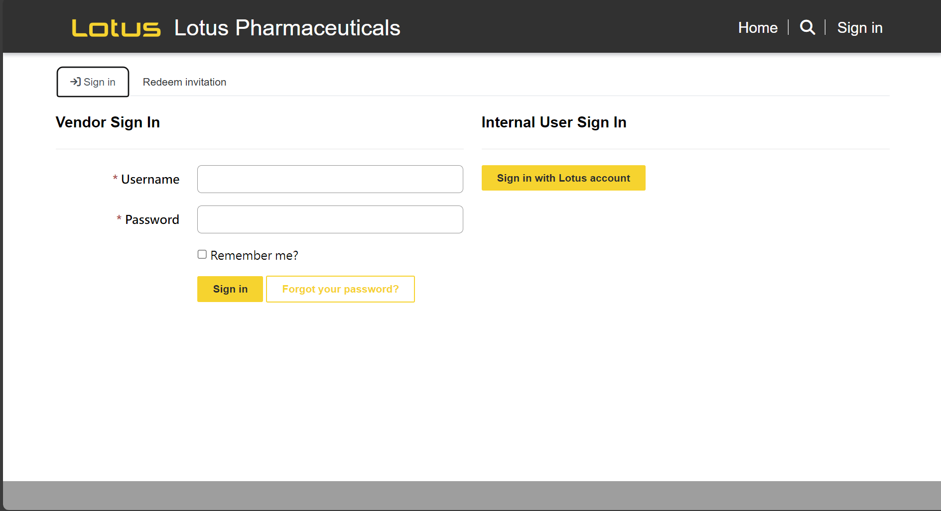
供應商入口網站 Connect data share between supplier and Lotus
整合
供應商入口網站將為整合所有供應商數據傳輸到美時的一個平台
供應商資料註冊
供應商管理計劃
交貨相關文件
即時
資料依供應商帳號分類儲存，有效減少資料歸檔及審閱時間
安全
供應商數據將受到存取控制的保護，並由供應商用戶ID進行管理
時程
預計推出時間：2025年第一季

Slide 35
感謝聆聽 Thank you for your participation

